Slide 1
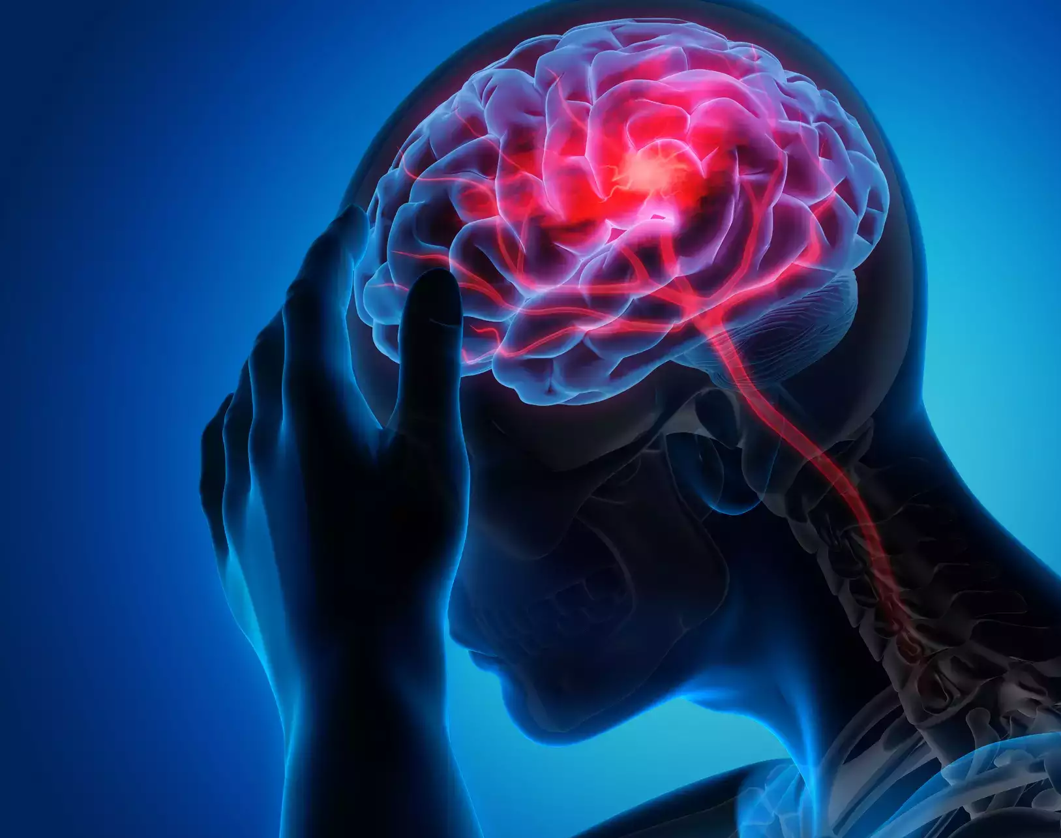

Brain Stroke Prediction
Jahedur Rahman
Data Science, Bellevue University
DSC 680: Applied Data Science
Professor Catie Williams
October 23, 2022
Notes:
Hello everyone.
My name is Jahedur Rahman, and I am here to talk to you about a project I worked on called Brain Stroke Prediction.

Slide 2
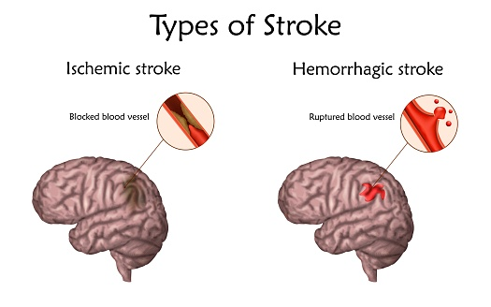
Background/History
A brain stroke is a medical condition where there is a lack of blood flow to the brain which can cause cell death.
An ischemic stroke is caused when there is a lack of blood flow.
A hemorrhagic stroke is caused when there is bleeding.
Both types cause parts of the brain to stop functioning properly.
Notes:
Here is some background and history about this project.
Many of us have heard of the medical condition called the Brain Stroke.
Some of us may know a family member or friend that have suffered from this condition.
A brain stroke is a medical condition where there is a lack of blood flow to the brain which can cause cell death.
There are two main types of stroke.
One is called an ischemic stroke.
This is caused when there is a lack of blood flow and can be due to a blocked blood vessel.
Another stroke is called a hemorrhagic stroke.
This is caused when there is bleeding and can be due to a ruptured blood vessel.
Both types of stroke cause parts of the brain to stop functioning properly.
A stroke may exhibit some signs and symptoms which include the inability to move or feel on one side of the body, problems understanding or speaking, dizziness, or loss of vision to one side.

Slide 3
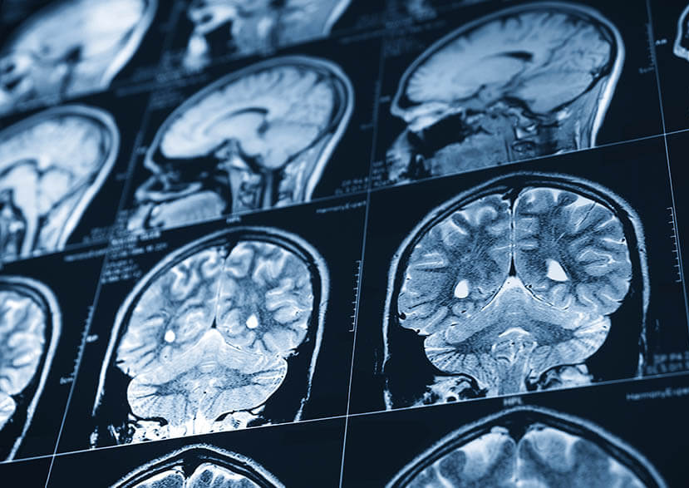
Business Problem
Many risk factors that can cause a stroke
high blood pressure, high blood cholesterol, tobacco smoking, obesity, diabetes mellitus, a previous TIA, end-stage kidney disease, and atrial fibrillation
The model will use some of these risk factors, and other factors, to predict if a stroke will happen to a person or not.
Notes:
The business problem is that medical professionals must be able to predict if a patient will have a brain stroke or not.
Using the signs and symptoms that a person exhibits; they should be able to predict it beforehand..
There are many risk factors that can cause a stroke.
Some of these are high blood pressure, high blood cholesterol, tobacco smoking, obesity, diabetes mellitus, a previous TIA, end-stage kidney disease, and atrial fibrillation.
This model will use some of these risk factors, and other factors, to predict if a stroke will happen to a person or not.

Slide 4
Dataset
The Brain stroke prediction dataset is the primary dataset used for this project
gender: "Male", "Female"
age: age of the patient
hypertension: 0 if the patient doesn't have hypertension, 1 if the patient has hypertension
heart_disease: 0 if the patient doesn't have any heart diseases, 1 if the patient has a heart disease
ever_married: "No" or "Yes"
work_type: "children", "Govtjov", "Neverworked", "Private" or "Self-employed"
Residence_type: "Rural" or "Urban"
avg_glucose_level: average glucose level in blood
bmi: body mass index
smoking_status: "formerly smoked", "never smoked", "smokes" or "Unknown"*
stroke: 1 if the patient had a stroke or 0 if not
Notes:
The dataset I am using is the Brain stroke prediction dataset found on Kaggle.
This dataset has 11 columns.
During the data preparation process none of the columns were removed since all of them were important variables.
Some examples of important features include hypertension, heart_disease, avg_glucose_level, body mass index, smoking_status, and stroke
In addition, there were no null values, so no records or rows had to be removed.
The target variable in this dataset is the stroke column.
There are two stroke values.
A stroke value of 0 means the patient didn’t have a stroke,
A stroke value of 1 means the patient did have a stroke

Slide 5
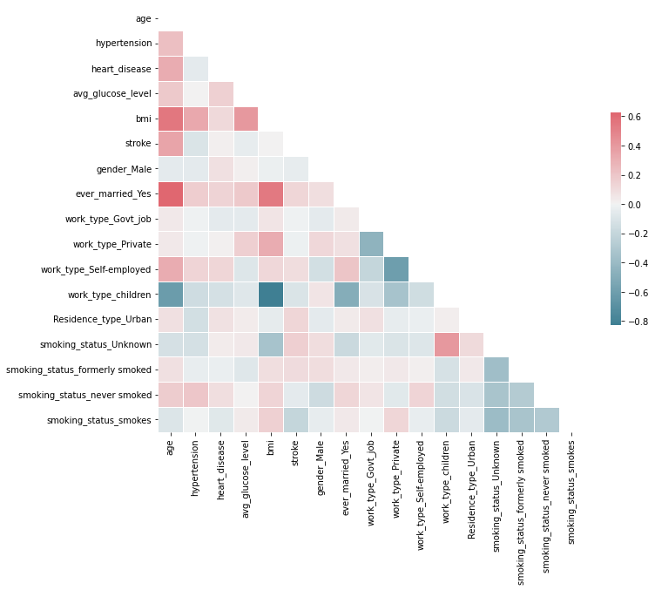
Methods and Analysis
Strong correlation between ever_married_Yes and age
Positive correlation between:
stroke and age
bmi and age
ever_married_Yes and bmi
Negative correlation between:
work_type_children and age
work_type_children and bmi
Notes:
Before modeling the dataset,
I did some analysis to the dataset.
I wanted to find if there were any correlations between the variables in the dataset.
The heatmap shown on this slide is a visual representation of the correlations between each variable.
A square with a red color interprets to a strong positive correlation between the two variables that cross that square.
A square with a white or lighter color interprets to a weak or no correlation between the two variables that cross that square.
A square with a blue color interprets to a strong negative correlation between the two variables that cross that square.
We can see here that there is a strong correlation between ever_married_Yes and age.
Unfortunately, this doesn’t help us with figuring out if this affects a stroke or not
In addition, there is a positive correlation between
stroke and age
bmi and age
ever_married_Yes and bmi
Additionally, there is a negative correlation between
work_type_children and age
work_type_children and bmi

Slide 6
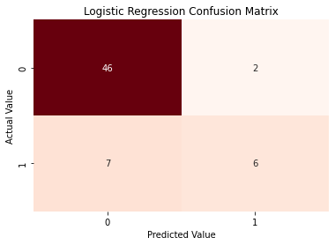
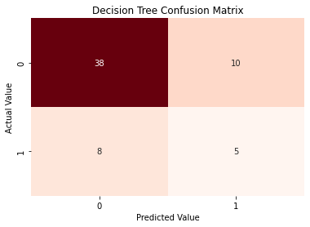
Methods and Analysis
Logistic Regression Model
85% accuracy score
Correctly predicted 52 out of 61 values
Incorrectly predicted 9 out of 61 values
Decision Tree Classifier
70% accuracy score
Correctly predicted 43 out of 61 values
Incorrectly predicted 18 out of 61 values
Notes:
Now time to talk about modeling the data.
I built and tested three different types of modeling algorithms
The first modeling algorithm I built was a logistic regression model.
The results of the model produced an 85% accuracy score.
In addition, the heatmap shows that the model correctly predicted 52 out of 61 values
And incorrectly predicted 9 out of 61 values
To compare these results I built two other models, the Decision Tree Classifier and the Random Forest Classifier
The Decision Tree Classifier produced an accuracy score of 70%
the heatmap shows that the model correctly predicted 43 out of 61 values
And incorrectly predicted 18 out of 61 values
So far the results for the logistic regression model are better than the results for the Decision Tree Classifier
Now lets look at the Random Forest Classifier

Slide 7
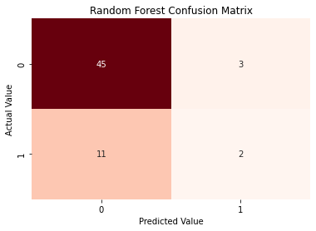
Methods and Analysis
Random Forest Classifier
77% accuracy score
Correctly predicted 47 out of 61
Incorrectly predicted 14 out of 61 values
Notes:
The Random Forest Classifier produced an accuracy score of 77%
the heatmap shows that the model correctly predicted 47 out of 61
And incorrectly predicted 14 out of 61 values
These results are better than the results produced by the decision tree classifier
but not as good as the results produced by the logistic regression model
Based on these results it looks like the logistic regression model is the best model

Slide 8
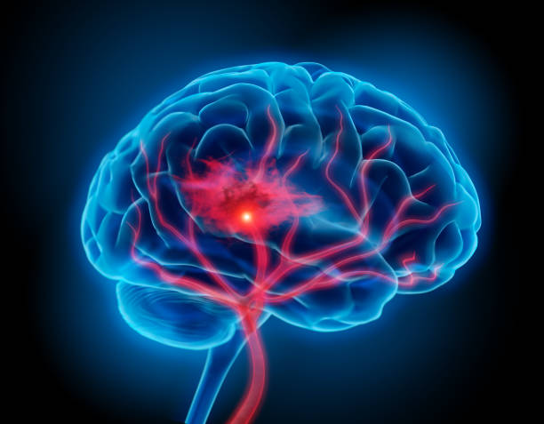
Conclusion
Logistic regression model predicts a brain stroke accurately
The model can be used to predict a brain stroke.
To make the model even more accurate, in the future values in the dataset must be looked through thoroughly and corrective actions should be taken.
Additional variables should be added.
Notes:
The Logistic regression model predicts a brain stroke accurately
To make the model even more accurate, in the future values in the dataset must be looked through thoroughly and corrective actions should be taken to fix or remove these values
In addition, Additional variables should be added such as high blood cholesterol, tobacco smoking, obesity, diabetes mellitus, a previous TIA, end-stage kidney disease, and atrial fibrillation

